Slide 1


TITLE HERE
Work Status Report as on 3rd March,23

Slide 2
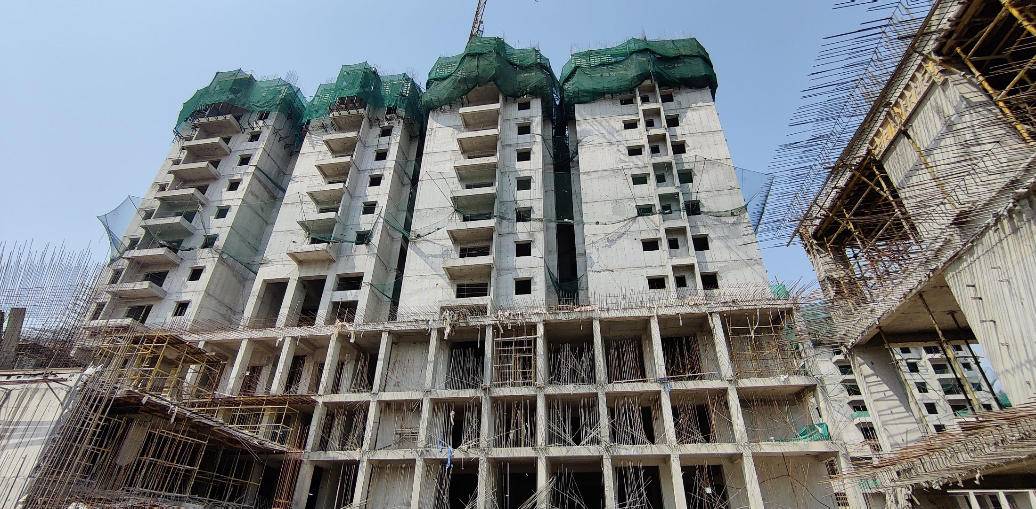
My Home “SAYUK” Tower-“01”
8th Floor roof slab works in progress

Slide 3

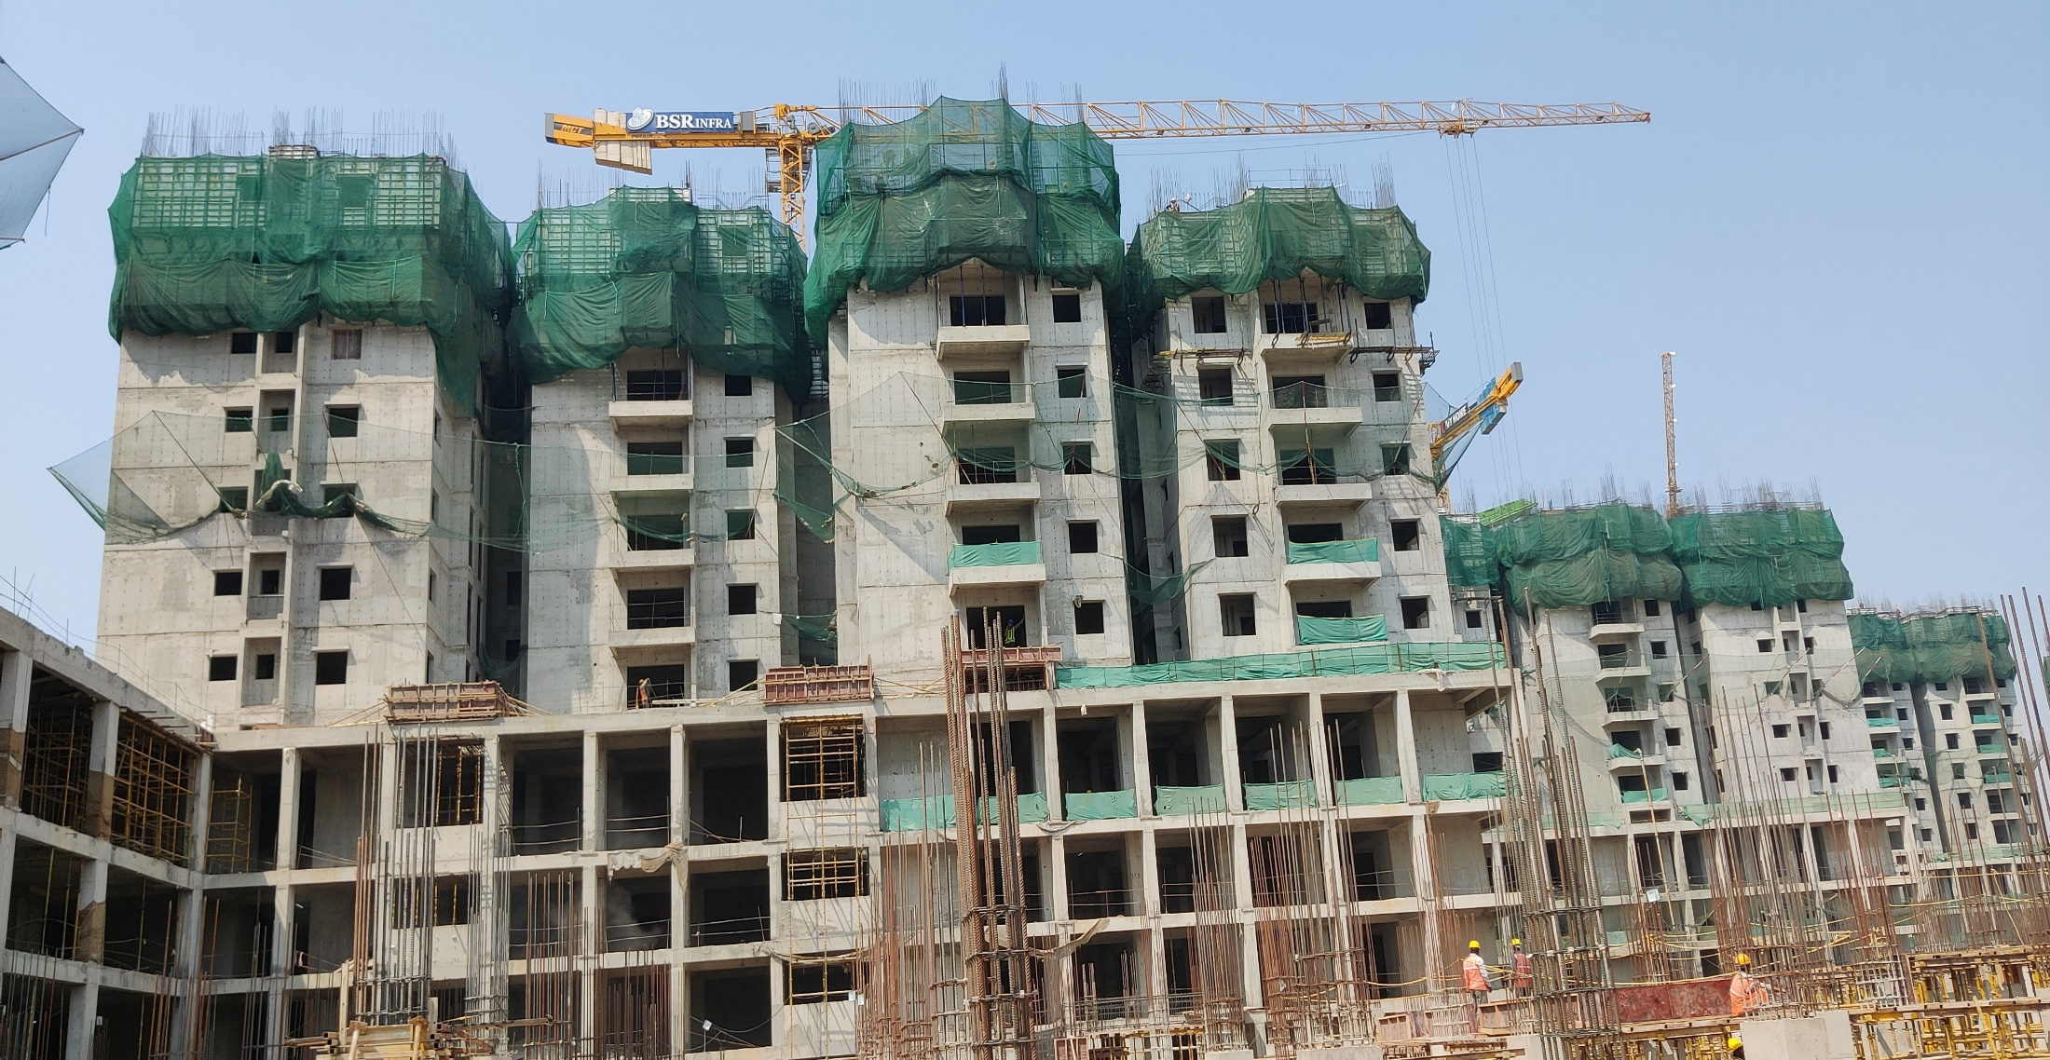
My Home “SAYUK” Tower-“02”
5th & 6th Floors roof slabs works in progress

Slide 4

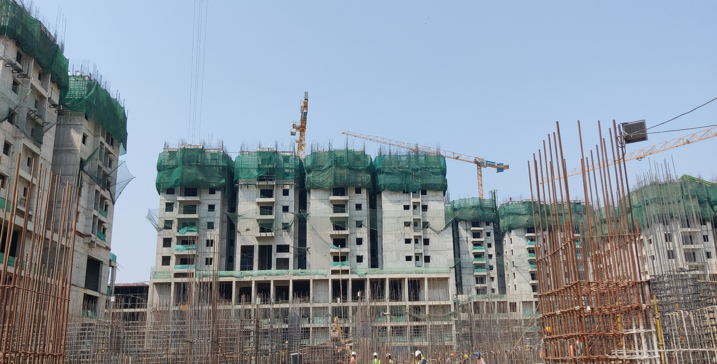
My Home “SAYUK” Tower-“03”
6th Floors roof slabs works in progress

Slide 5

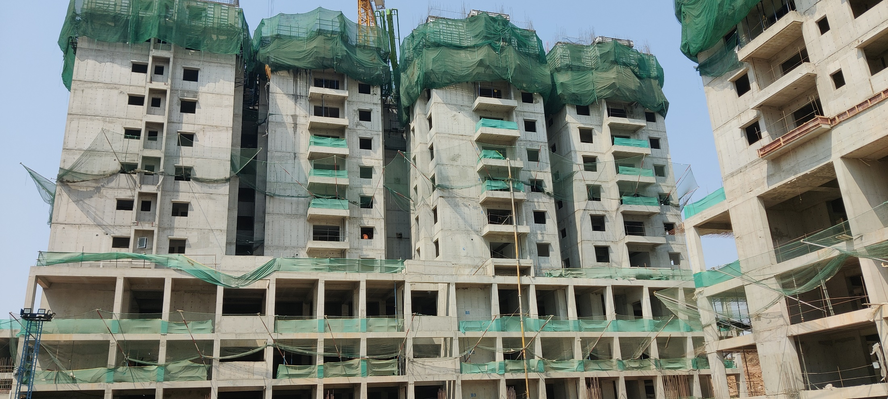
My Home “SAYUK” Tower-“04”
7th Floors roof slabs works in progress

Slide 6

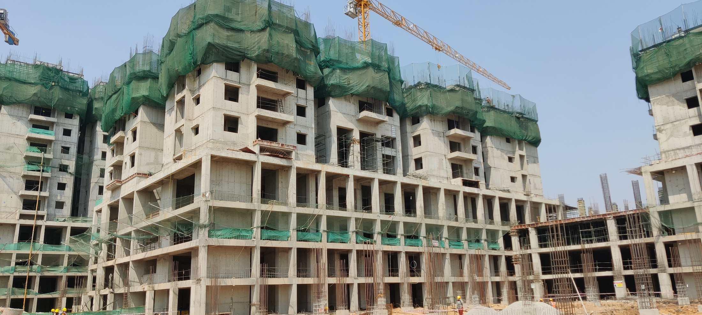
My Home “SAYUK” Tower-“05”
3rd & 4th floors roof Slabs works in progress

Slide 7
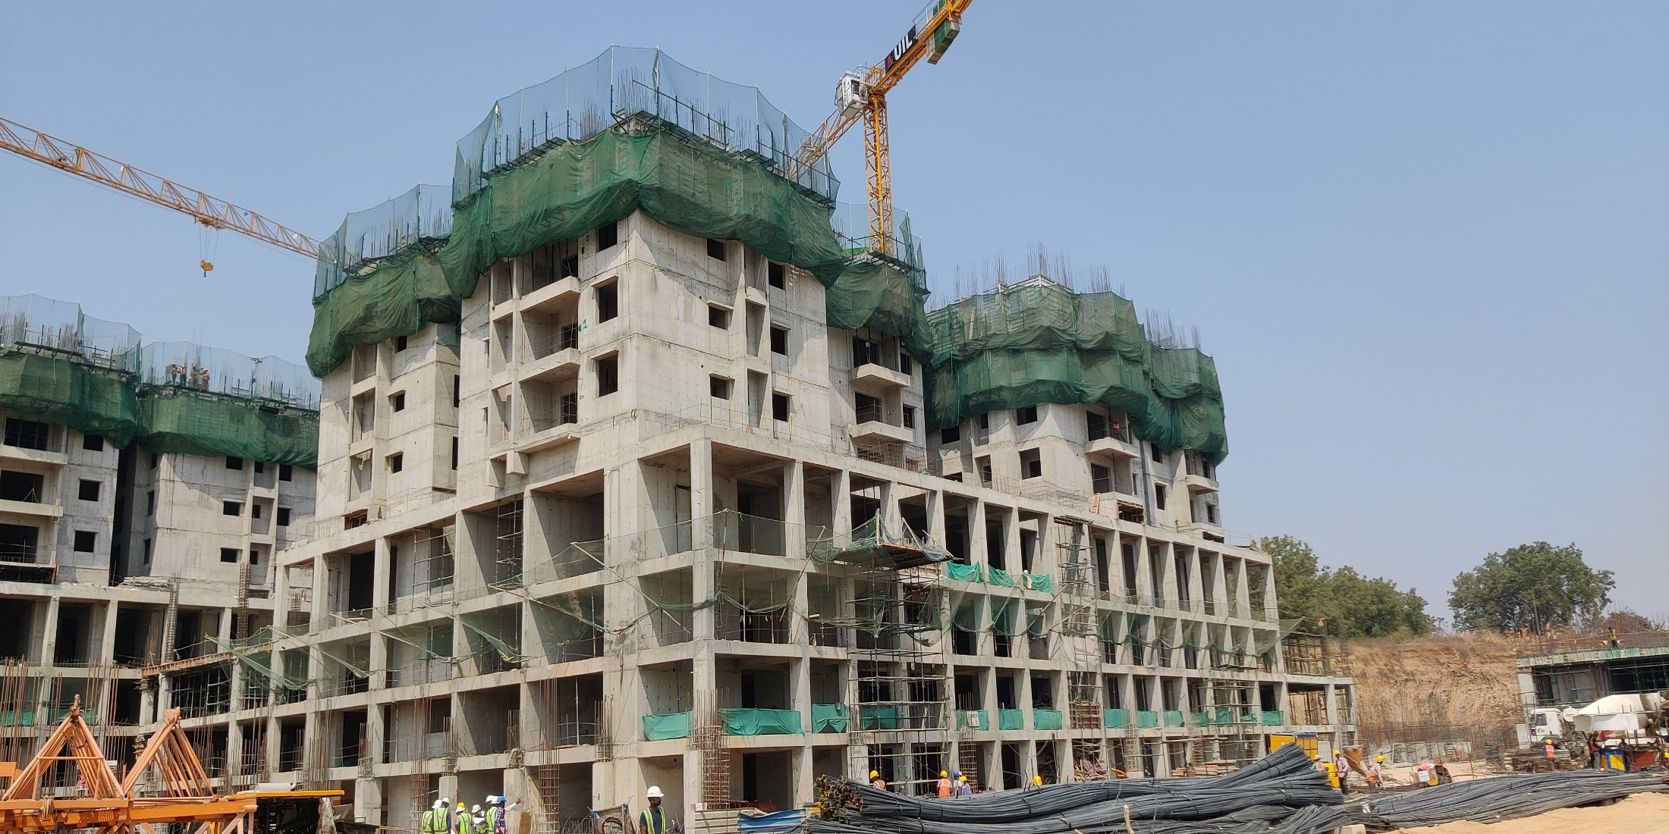
My Home “SAYUK” Tower-“06”
3rd floor roof Slab works in progress

Slide 8
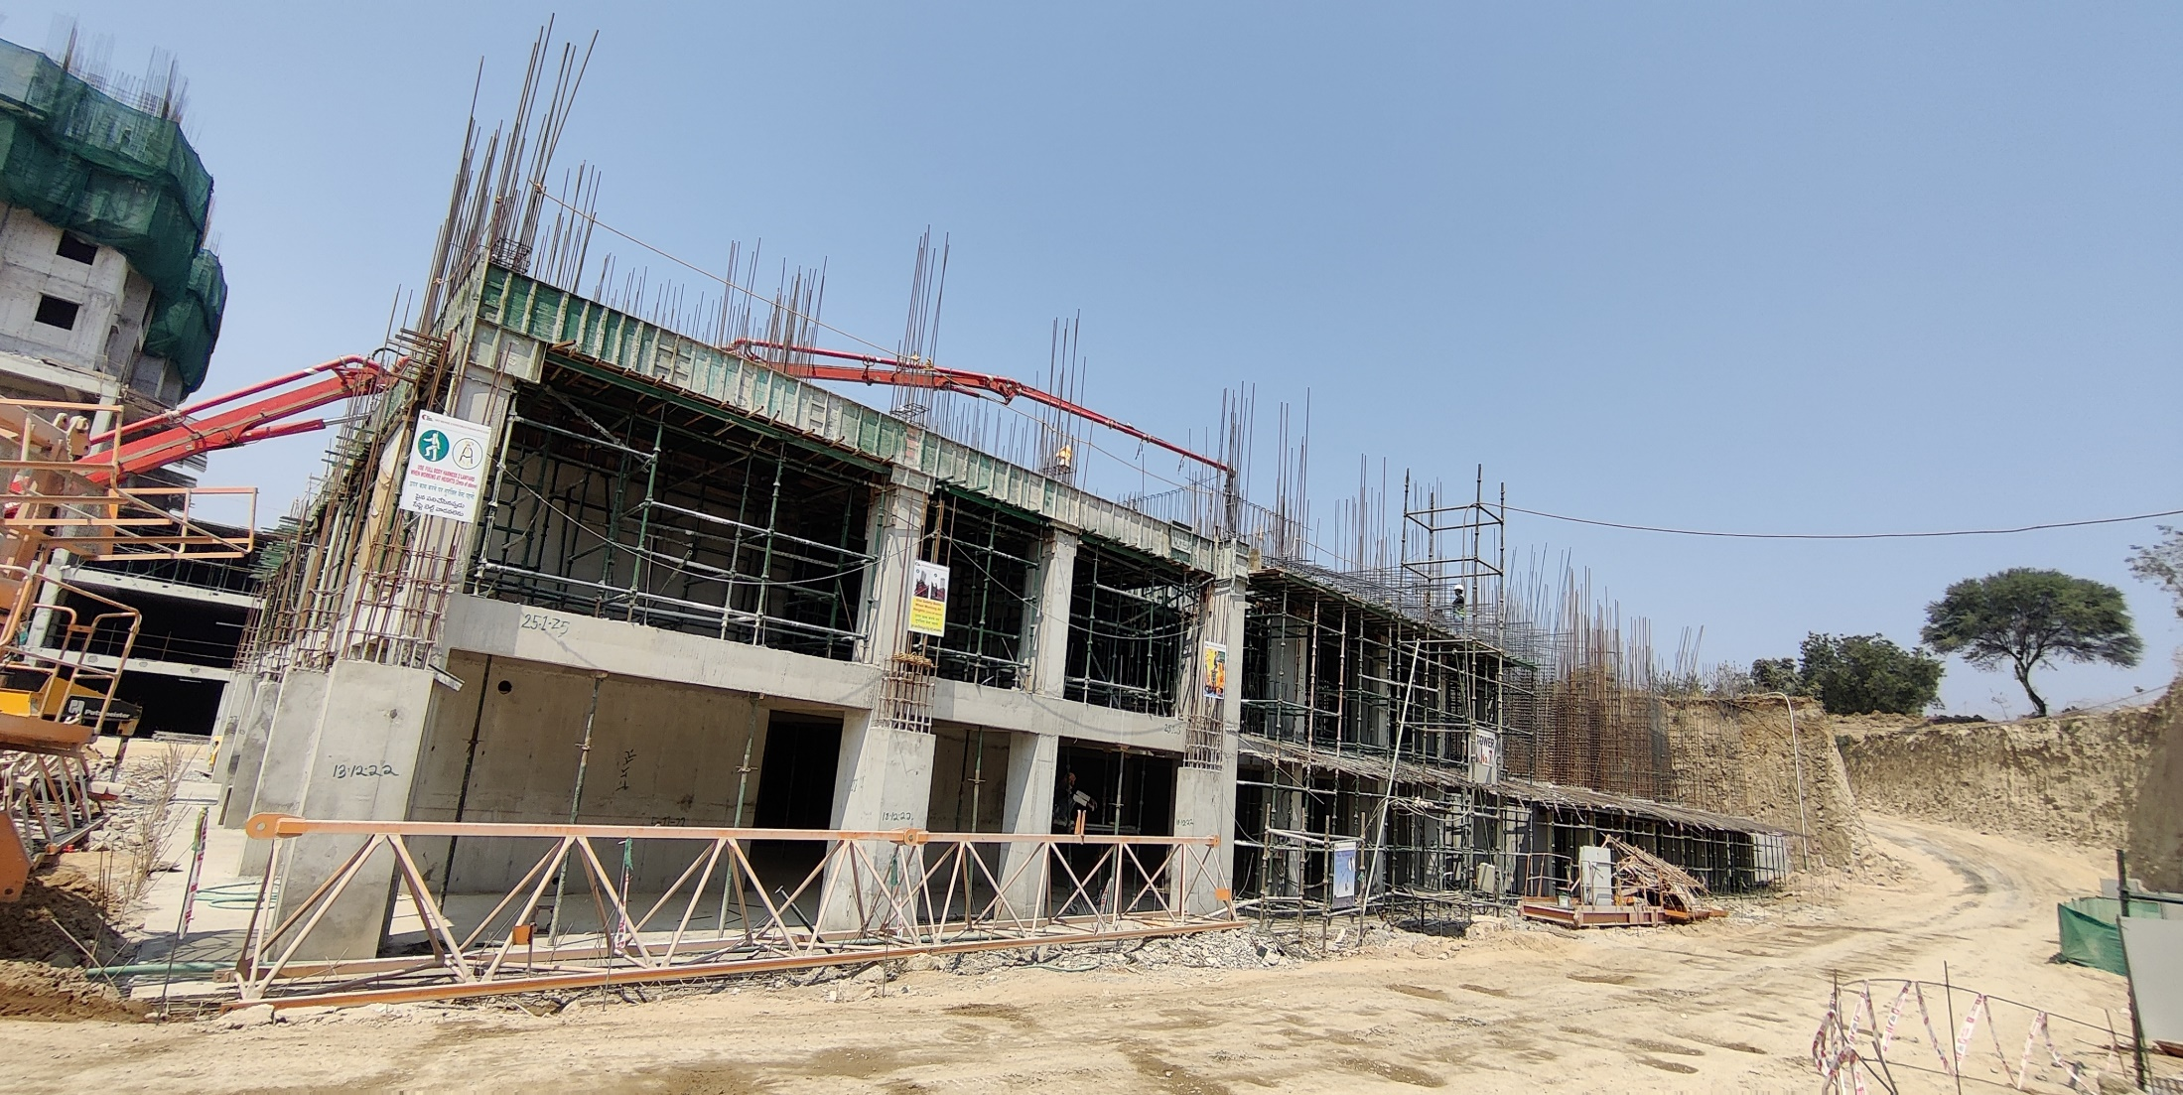
My Home “SAYUK” Tower-“07”
Basement-III roof slab Works in Progress

Slide 9
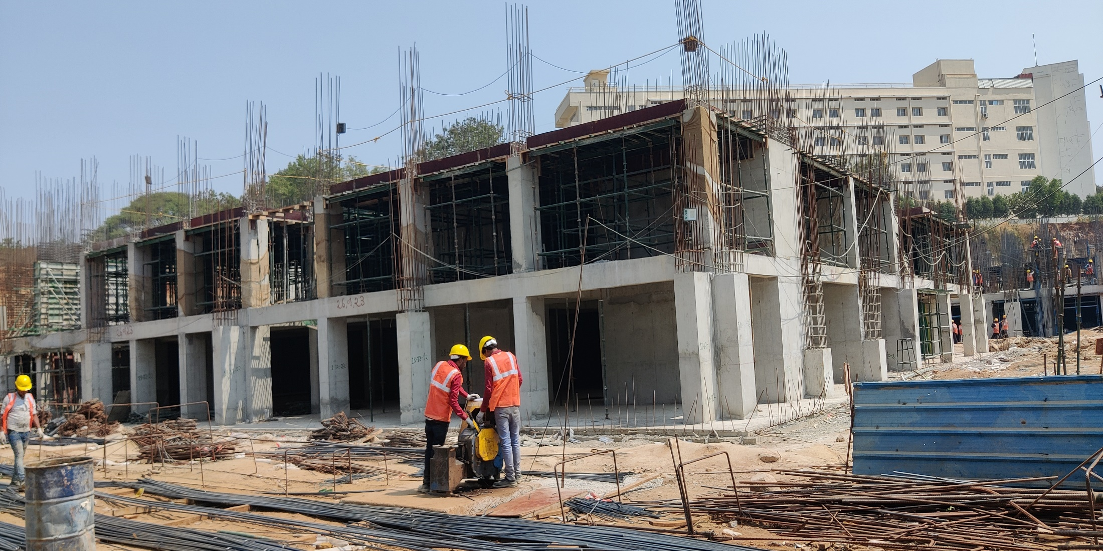
My Home “SAYUK” Tower-“08”
Basement-III roof slab Works in Progress

Slide 10
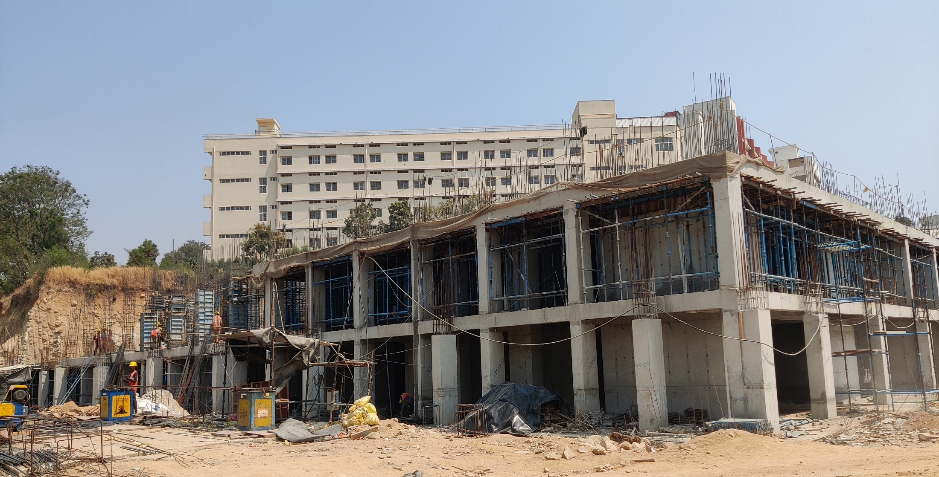
My Home “SAYUK” Tower-“09”
Basement-III roof slab Works in Progress

Slide 11
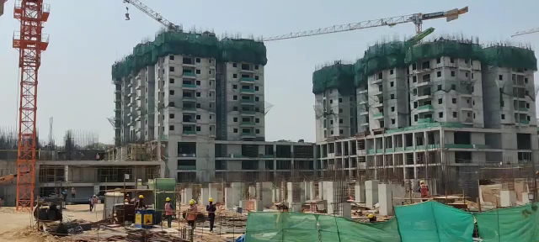
My Home “SAYUK” “Video”
For Video-Click on the Video

